Slide 1

Intro to AI
part1

Slide 2

Agenda
Introduction (What is AI, history, The value of AI, and ANI vs AGI).
ML (Definitions, types of ML, what makes AI so powerful recently?).
Supervised (Examples, how most of AI problems is around it).
Un-supervised (why it's needed, and problem it solves in the real world).
Data (how it worth?, types of data, its resources, Use and misuse of data, data is messy).
Data Science

Slide 3

What is AI
For years, people viewed computers as machines which can perform mathematical operations at a much quicker rate than humans.
Then, scientists, and researchers' wonders how would we write algorithms for these tasks:
A song comes on the radio, most listeners of music can quickly identify the genre, maybe the artist, and probably the song.
An art critic sees a painting he’s never seen before, yet he could most likely identify the era, the medium, and probably the artist.
A baby can recognize her mom’s face at a very early age.
The simple answer is that you can’t write algorithms for these. Algorithms use mathematics.
So, how we achieve this?
Notes:
But, What Exactly Is AI?. A simple answer to a complex question | by Rich Folsom | Towards Data Science

Slide 4
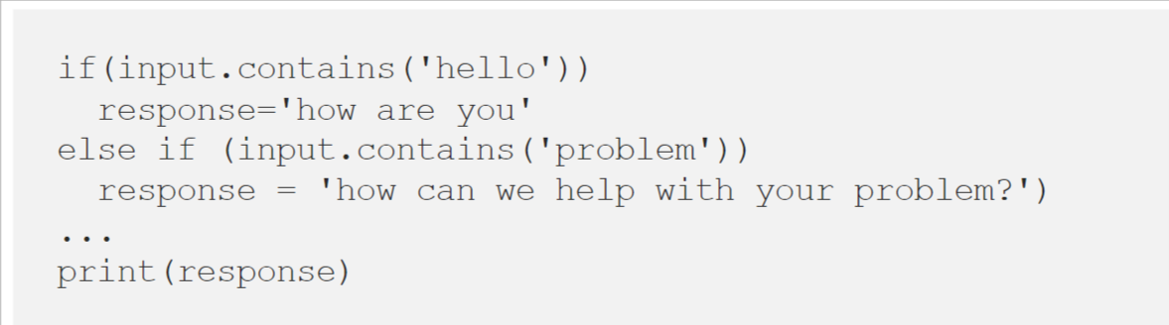
What is AI, Cont.
Scientists found that: humans were able to achieve these results because they learned to do these things over time.
Simply put, AI means to program a machine to behave like a human (simulate human beings).
The terms Artificial Intelligence(AI) have been used since the 1950s. At that time, it was viewed as a futuristic, theoretical part of computer science.
In the beginning, researchers developed algorithms to try to approximate human intuition. A way to view this code would be as a huge if/else statement to determine the answer (using prepositional logic).

Slide 5
$13 Trillion
AI value creation by 2030
Source: McKinsey Global Institute

Slide 6
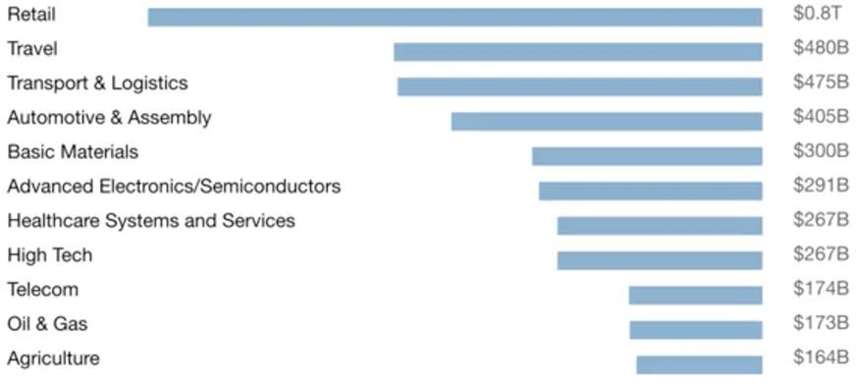
The value AI can make
A lot of the value created by AI will be outside the software industry. AI will have a huge impact on all the major industries.

Slide 7
Main AI types
There are 2 types of AI
ANI
Artificial Narrow Intelligence
ALMOST NO PROGRESS
AGI
Artificial General Intelligence
LOTS OF PROGRESS

Slide 8
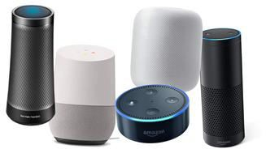
Artificial Narrow Intelligence (ANI)
These are AIs that do one thing such as:
smart speaker
self-driving car
AI to do web search
AI applications in farming or in a factory.
In short most of AI apps we have right now is ANI apps.
So, ever we have all this powerful apps, what will AGI be like?!

Slide 9

Artificial General Intelligence (AGI)
That is the goal to build AI.
They can do anything a human can do or maybe even be super-intelligent and do even more things than any human can.

Slide 10
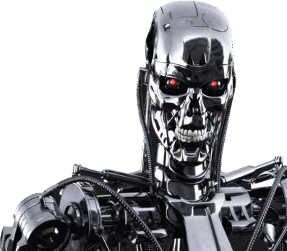
Progress in ANI vs AGI
The rapid progress in ANI has caused people to conclude that there's a lot of progress in AI, which is true. But that has caused people to falsely think that there might be a lot of progress in AGI as well which is leading to some irrational fears about evil clever robots coming over to take over humanity anytime now.
So, AGI only exist in Netflix movies ☺.

Slide 11
Machine Learning

Slide 12
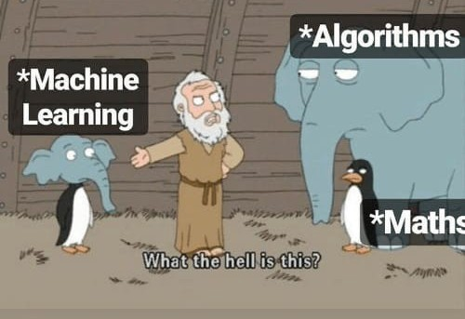
Machine Learning Intro
Machine learning is the main branch of artificial intelligence.
In machine learning, numerical data is used to train computers to complete specific tasks.
ML programs does not have to be explicitly programmed to solve the problems.
An algorithm is nothing more than a series of instructions followed by a computer, and ML is like an intelligent algorithm.
look at this pic. ☺
Notes:
What is machine learning: how I explain the concept to a newcomer | by Andrew D #datascience | Towards Data Science

Slide 13



Supervised Learning
If the input is an audio clip, and the AI's job is to output the text transcript, then this is speech recognition.
Input (A) Audio
Output (B) Text (0/1)
Application Speech Recognition

Slide 14



Supervised Learning
If you want to input English and have it output a different language, Chinese, Spanish, something else, then this is machine translation.
Input (A) English
Output (B) Chinese
Application Machine Translation

Slide 15




Supervised Learning
All the large online ad platforms have a piece of AI that inputs some information about an ad, and some information about you, and tries to predict, will you click on this ad or not?
Input (A) Ad + User Info
Output (B) Click? (0/1)
Application
Ads Analysis

Slide 16
Supervised Learning
This set of AI called supervised learning, just learns input to output, or A to B mappings. On one hand, input to output, A to B it seems quite limiting. But when you find a right application scenario, this can be incredibly valuable.
Most of ML problems you see will be supervised.
And this is the first type of ML.

Slide 17
Please Fill out this Form

Slide 18
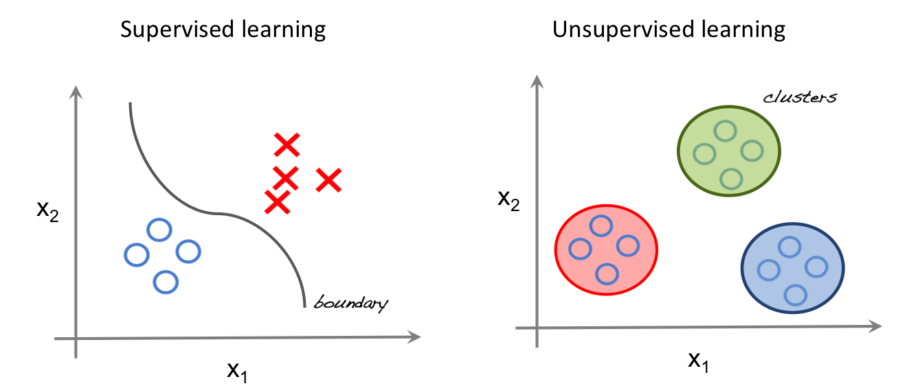
Un-Supervised Learning
Labeling data is really time consuming and need a lot of resources.
So, how we can deal with un-labeled data? Thus, where un-supervised learning came from.
The main difference between supervised vs unsupervised learning is the need for labelled training data. Supervised machine learning relies on labelled input and output training data, whereas unsupervised learning processes unlabeled or raw data.
Notes:
www.seldon.io/supervised-vs-unsupervised-learning-explained

Slide 19
Un-Supervised Learning Examples
Customer segmentation or understanding different customer groups around which to build marketing or other business strategies.
Genetics, for example clustering DNA patterns to analyze evolutionary biology.
Recommender systems, which involve grouping together users with similar viewing patterns in order to recommend similar content.
Anomaly detection, including fraud detection or detecting defective mechanical parts (i.e., predictive maintenance).
So, in short un-supervised learning is well suited for detecting patterns, understanding(analyzing) your data, and groups clustering.
Notes:
blog.dataiku.com/unsupervised-machine-learning-use-cases-examples

Slide 20
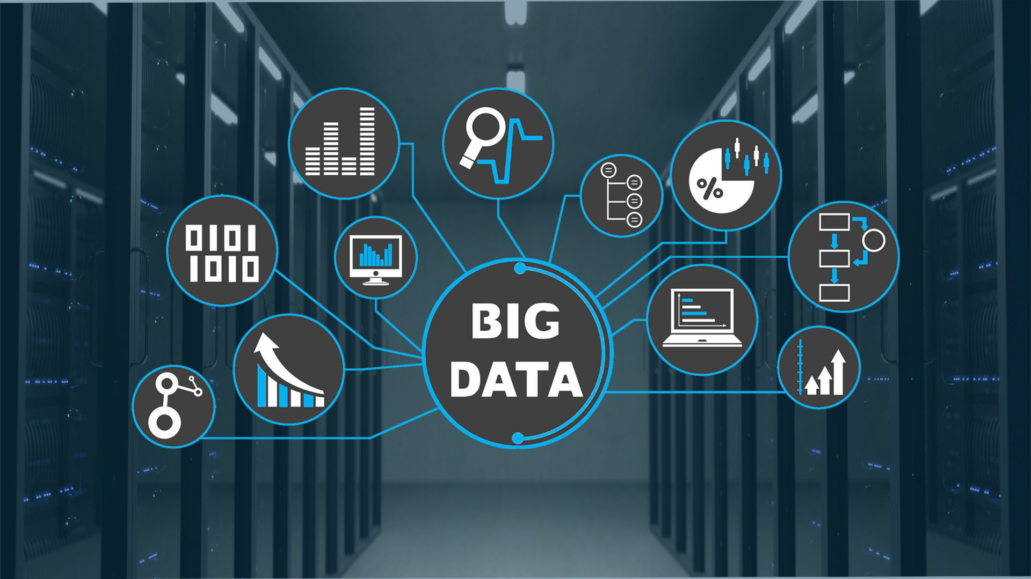
720,000 hours, this is the total # of hours uploaded to YouTube daily.
Notes:
www.oberlo.com/blog/youtube-statistics

Slide 21
Why, Now?

Slide 22
The Rise of Fast Computers
So, the rise of fast computers with specialized processors such as graphics processing units or GPUs has enabled many companies, not just gianttech companies, but many many other companies to be able to train large neural nets on a large enough amount of data in order to get very good performance and drive business value.

Slide 23
What enables machine learning to work so well?

Slide 24
What is Data?!

Slide 25
A Table of Data (Dataset)
Size of House (Square Feet) | # of Bedrooms | Price ($1000)
523 | 1 | 115
645 | 1 | 150
708 | 2 | 210
1034 | 3 | 280
2290 | 4 | 355
2545 | 4 | 440
A |  | B

Slide 26
Another Example (house size prediction)
If you have a certain budget and you want to decide what is the size of house you can afford, then you might decide that the input A is how much does someone spend and B is just the size of the house in square feet, and that would be a totally different choice of A and B that tells you, given a certain budget, what's the size of the house you should be maybe looking at.

Slide 27

Acquiring data (Different data sources)
Manual labeling

Slide 28
Acquiring data
From observing behaviors of humans.
(like getting data from database, filling forms).
User ID | Time | Price ($) | Purchased
4783 | Jan 21 08:15.20 | 7.95 | yes
3893 | Mar 3 11:30.15 | 10.00 | yes
8384 | Jun 11 14:15.05 | 9.50 | no
0931 | Aug 2 20:30.55 | 12.90 | yes

Slide 29
Acquiring data
Download from websites / partnerships
Thanks to the open internet you can find so many datasets available for free online:
Computer vision or image datasets
Self driving car datasets
Speech recognition datasets
Medical imaging datasets

Slide 30
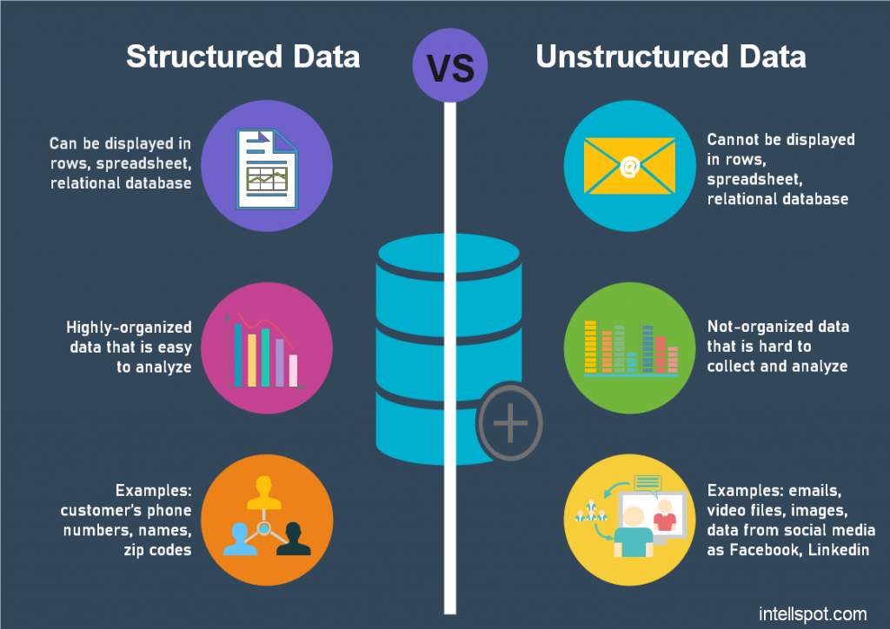
Data Main Types

Slide 31


Use and misuse of data
Give me three years to build up my IT team, we're collecting so much data.
Then after three years, I'll have this perfect dataset.
We'll do AI then.
What’s wrong with this approach?

Slide 33
Use and misuse of data
it turns out that's a really bad strategy.
Once you've started collecting some data, go ahead and start showing it or feeding it to an AI team.
Then the AI team can give feedback to your IT team on what types of data to collect and what types of IT infrastructure to keep on building.

Slide 34

Machine Learning vs Data Science
Machine Learning
“Field of study that gives computers the ability to learn without being explicitly programmed.”
- Arthur Samuel (1959).
A machine learning project will often result in a piece of software that runs, that outputs B given A.

Slide 35
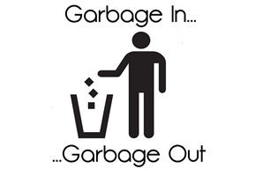
Data is Messy
If you have bad data, then the AI
will learn inaccurate things.
1.Data problems:
Incorrect labels
Missing values
2.Multiple types of data
Unstructured Data: Images, audio, text.

Slide 36
Data Science
If you want to have a team analyze your dataset in order to gain insights. The output of a data science project is a set of insights that can help you make business decisions
So, a team might come up with conclusions like:
"Hey, did you know if you have two houses of a similar size, they've a similar square footage, if the house has three bedrooms, then they cost a lot more than the house of two bedrooms, even if the square for this is the same."

Slide 37
Formal Definition of Data Science
Data science is the science of extracting knowledge and insights from data.
So, the output of a data science project is often a slide deck, the presentation summarizes conclusions to take business actions or summarizes conclusions for a product team to decide how to improve the product.

Slide 38
Machine Learning vs Data Science In Action
Large platforms have AI that quickly tells them what’s the ad you’re most likely to click on. This is a machine learning system. It inputs information about the user and about the ad and outputs whether the user will click on the ad or not.
Notes:
towardsdatascience.com/mlevsds-3c89425baabb

Slide 39


